Slide 1
Come up and say hello!

Slide 2
CPSC 221: Algorithms and Data Structures Lecture #0: Introduction
Raise your hand if you can read.
Raise your other hand if you can write.
Stand up if you can think.
WHOOP if you can talk.
Point: this classroom is not sacred ground.
FIBONACCI
Steve Wolfman
2014W1
Notes:
TODO (future terms): change term
Raise your hand if you can read.
Raise your other hand if you can write.
Stand up if you can think.
WHOOP if you can talk.
Point: this classroom is not sacred ground. I am not a fearsome taskmaster. Please take part in this class, the most horrible thing in the world for an instructor is unresponsive students; don’t be my nightmare!
WARNING, however, we have tons of FANTASTIC stuff to talk about. I’m going to talk about it FAST, and you HAVE to ask questions to slow me down.

Slide 3

Fibonacci
0
+
=
1, 1, 2, 3, 5, 8, 13, 21, …
Applications, in order of importance:
Fun for CSists
Brief appearance in Da Vinci Code
Endlessly abundant in nature: http://www.youtube.com/user/Vihart?feature=g-u#p/u/1/ahXIMUkSXX0

Slide 4
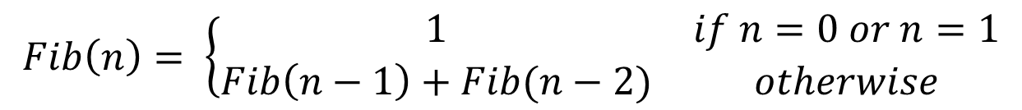
Fibonacci
0
+
=
Definition:

Slide 5
Fibonacci
0
+
=
Easy to implement as recursive code, right?
Let’s try it.
(Then, we’ll open up a big can of data structures and algorithms on that problem.)
Notes:
TODO: collect example Fibs for discussion in class!
LIVE code the simpler parts: plain recursive, memoized, DP, and possibly matrix multiplication ☺
Use time (on UNIX, may want to use /usr/bin/time, just for consistency; csh has a built-in timing command that shadows that).
Plain recursive solution
Chipping away at the plain solution in several ways:
General algorithm techniques to handle “overlapping subproblems”
WHY does it take so long: Adding in a simple data structure to get the MEMOIZED solution
How much of the data structure do we need? Altering the algorithm to build “bottom-up” rather than “top-down” to get DP solution
Thinking hard about the algorithm gives us a clever alternative
Matrix representation using [ 1 1 ] [ 1 0 ] (that IS a set of fib #s, and multiplying by that gives us the next set of Fibonacci numbers!)
A more efficient way to raise to powers
Number representation and arbitrary precision
What should we really measure when we measure performance?
Something that’s always “fast” (takes less than some small time limit), not something that might get quite expensive depending on the inputs!!
Parallelism!
NEXT SLIDE: closed form “approximation” (efficient power implementation still helps)

Slide 6
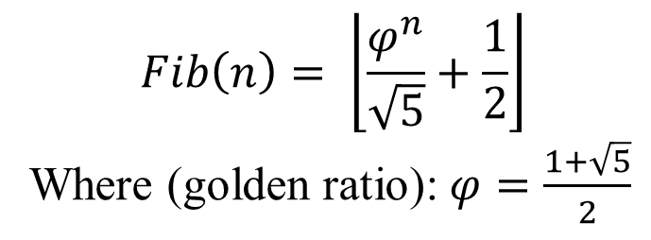
Fibonacci
0
+
=
(Exact) Approximation:
But how long to raise phi to the n power?
What algorithm?
Notes:
Generating functions?

Slide 7
Today’s Outline
Administrative Cruft
Overview of the Course
Queues
Stacks
Notes:
I’m going to try to tell you at the start of each class what I’ll be covering. Here’s today.
Once we get done with some administrative cruft, we’ll get into the exciting stuff.

Slide 8
Course Information
Swore you could read; so, skimming…
Your Instructor: Steve Wolfman
ICCS 239
wolf@cs.ubc.ca
Office hours: see website
Other Instructor: Kendra Cooper (OHs: see website)
Tas and their office hours: see website, more may be posted!
Texts: Epp Discrete Mathematics, Koffman C++
(But… feel free to get alternate texts or versions)
Notes:
TODO (future terms): fix co-instructor, double-check texts
Now you swore to me that you could all read, so I’ll just skim over the administrative cruft and hit the high notes.
All this is old news. I’ll also say that I’m going to try to be available after each class for at least a few minutes.
Introduce myself (and Tas introduce themselves if present)

Slide 9
Course Policies
No late work; may be flexible with advance notice
(why? so we can post solutions/discussion quickly!)
Programming projects (~3?) due 9PM, usually Fridays
Quizzes (~5?) online on Fridays (due time TBD)
Written corrections of quizzes due 5PM the following Wed
Grading
labs: 10%
quizzes/written assns: 15%
programming projects: 15%
midterms: 25%
final: 30%
your best of the above: 5%
Must pass the final to pass the course.
Notes:
TODO (future terms): double-check policies

Slide 10
Collaboration
READ the collaboration policy on the website.
You have LOTS of freedom to collaborate!
Use it to learn and have fun while doing it!
Don’t violate the collaboration policy. There’s no point in doing so, and the penalties are so severe that just thinking about them causes babies to cry*.
*Almost anything causes babies to cry, actually, but the cheating penalties really are severe.

Slide 11
Course Mechanics
GO TO THIS WEBSITE!
TEST ON THE UNIX G++ COMPILER ON ugrad MACHINES!
221 Web page: www.ugrad.cs.ubc.ca/~cs221
221 Piazza site at piazza.com
Quizzes and grades on Connect (sorry!)
Labs are in ICCS X350 and X251
use the “Linux” logon to the computers
All programming projects graded on UNIX/g++
Notes:
TODO (future terms): check online resources, check lab room, check machines in lab
GO TO THIS WEB SITE! This and the Vista site will be the primary methods for distributing information.
Note that the programming projects will be graded on UNIX with the g++ compiler. This means: TEST ON UNIX WITH THE G++ COMPILER! Even if you don’t develop with those tools.
OK, that’s it for administrative details. Now, the question on all your minds should be…

Slide 12
Today’s Outline
Administrative Cruft
Overview of the Course
Queues
Stacks
Notes:
I’m going to try to tell you at the start of each class what I’ll be covering. Here’s today.
Once we get done with some administrative cruft, we’ll get into the exciting stuff.

Slide 13
Observation
Your knowledge of data structures affects what and how well you can program!
helps you grok what’s possible to compute.
All programs manipulate data
programs process, store, display, gather
data can be numbers, images, sound (information!)
Each program must decide how to store and manipulate data
Choice influences program at every level
execution speed
memory requirements
maintenance (debugging, extending, etc.)
How you structure your data matters to every program you create!
Notes:
Given the importance of data, every program uses it, your knowledge of data structures affects what and how well you can program!
Moreover, it helps you understand what is possible to compute.

Slide 14
Goals of the Course
Stealing from Alan Hu:
Great artisans in any field study the classics
“Like intelligence in a can!”
Become familiar with some of the fundamental data structures and algorithms in computer science
Improve ability to solve problems abstractly
data structures and algorithms are the building blocks
Improve ability to analyze your algorithms
prove correctness
gauge, compare, and improve time and space complexity
Become modestly skilled with C++ and UNIX, but this is largely on your own!
Notes:
This course is designed to familiarize you with the most basic and important data structures in computer science. The ones that will form the foundation of all your future work with computers.
Moreover, you’ll learn how to analyze your programs and data structures so that you know how well they work and what sort of effort in the program is acceptable.
These are the goals of the course as well as my expectations of you.

Slide 15
What is an Abstract Data Type?
Abstract Data Type (ADT) – a mathematical description of an object and the set of operations on the object.
Maybe more usefully: a description of how a data structure works.. which could be implemented by many different actual data structures.
Notes:
Given that this is computer science, I know you’d be disappointed if there were no acronyms in the class. Here’s our first one!
Now, what an ADT really is is the interface of a data structure without any specification of the implementation.
In this class, we’ll study groups of data structures to implement any given abstract data type. In that context…

Slide 16
Data Structures as Algorithms
Often MANY DS’s for one ADT
Algorithm
A high level, language independent description of a step-by-step process for solving a problem
Data Structure
A set of algorithms which implement an ADT (well… and a bit more like the state of the structure)
Notes:
A data structure will be a set of algorithms for implementing an abstract data type.
One ADT often has many data structures implementing it.

Slide 17
Why so many data structures?
simple ADT, dictionary: like an actual dictionary, associates some short key info with longer description.
At least a dozen data structures, some quite complex. Why?
Ideal data structure:
fast, elegant, memory efficient
Generates tensions:
time vs. space
performance vs. elegance
generality vs. simplicity
one operation’s performance vs. another’s
serial performance vs. parallel performance
“Dictionary” or “Map” ADT
list
binary search tree
AVL tree
Splay tree
B+ tree
Red-Black tree
hash table
concurrent hash table
…
Notes:
Here’s a simple ADT. The dictionary: like an actual dictionary, it associates some short key piece of information with a longer description of that information. Simple as this interface is, there are at least a dozen data structures, some quite complex, which implement this ADT. Why?
Well, ideally, a data structure is ------------
But not all of these things can necessarily be achieved at once. This creates a set of conflicts which in turn lead us to create many data structures to “solve” any one abstract data type.

Slide 18
Code Implementation
Theoretically, nice realization in C++
Practically, some issues, which we’ll discuss.
Theoretically
abstract base class describes ADT
inherited implementations implement data structures
can change data structures transparently (to client code)
Practice
different implementations sometimes suggest different interfaces (generality vs. simplicity)
performance of a data structure may influence form of client code (time vs. space, one operation vs. another)
Notes:
The concepts of ADTs and data structures have a nice theoretical translation into C++ code.
Unfortunately, the same tensions which motivate the creation of many data structures for one ADT also affect the way client code might use one data structure over another for the same ADT
We’ll try to not only understand ADTs and data structures, but how to identify and resolve the issues that affect client code in choosing a data structure.

Slide 19
ADT Presentation Algorithm
Present an ADT
Motivate with some applications
Repeat until browned entirely through
develop a data structure for the ADT
analyze its properties
efficiency
correctness
limitations
ease of programming
Contrast data structure’s strengths and weaknesses
understand when to use each one
Notes:
Given those definitions, here’s our first algorithm.
This is how I’m going to try to present each set of data structures to you. You should hold me to this! You’re not getting enough out of the presentation if you don’t see these.
And look, here’s an ADT now…

Slide 20
Today’s Outline
Administrative Cruft
Overview of the Course
Queues
Stacks
Notes:
I’m going to try to tell you at the start of each class what I’ll be covering. Here’s today.
Once we get done with some administrative cruft, we’ll get into the exciting stuff.

Slide 21
Queue ADT
Notice: NO IMPLEMENTATION DETAILS
Queue operations
create
destroy
enqueue
dequeue
is_empty
Queue property: if x is enqueued before y is enqueued, then x will be dequeued before y is dequeued.
FIFO: First In First Out
F E D C B
G
enqueue
dequeue
A
Notes:
You’ve probably seen the Queue before. If so, this is a review and a way for us to get comfortable with the format of data structure presentations in this class. If not, this is a simple but very powerful data structure, and you should make sure you understand it thoroughly.
This is an ADT description of the queue. Notice that there are no implementation details. Just a general description of the interface and important properties of those interface methods.

Slide 22

Applications of the Q
Store people waiting to deposit their paycheques at a bank (historical note: people used to do this!)
Hold jobs for a printer
Store packets on network routers
Hold memory “freelists”
Make UBC’s waitlists fair!
Breadth first search
Notes:
Look for queue (and later stack) clipart, and this is what you get. A queue of people and a stack of pancakes (or books or money or paper or folders).
Qs are used widely in computer science. This is just a handful of the high profile uses, but _many_ programs use queues.

Slide 23
Abstract Q Example
enqueue R
enqueue O
dequeue
enqueue T
enqueue A
enqueue T
dequeue
dequeue
enqueue E
dequeue
In order, what letters are dequeued? (Can we tell, just from the ADT?)
Notes:
Let’s work through a quick example
2009W1: Used clickers with:
OATE
ROTA
OTAE
None of these, but it can be determined from just the ADT.
None of these, and it cannot be determined from just the ADT.

Slide 24
Circular Array Q Data Structure
LEAVE OPEN, try next example.
Q
0
1
2
…
7
…
11
…
size - 1
b
c
d
e
f
front
back
7
12
(int)
(int)
void enqueue(char x) {
Q[back] = x
back = (back + 1) % size
}
char dequeue() {
x = Q[front]
front = (front + 1) % size
return x
}
bool is_empty() {
return (front == back)
}
bool is_full() {
return front ==
(back + 1) % size
}
This is pseudocode. Do not correct my semicolons ☺
But.. is there anything else wrong?
Notes:
Here is a data structure implementation of the Q.
The queue is stored as an array, and, to avoid shifting all the elements each time an element is dequeued, we imagine that the array wraps around on itself.
This is an excellent example of how implementation can affect interface: notice the “is_full” function.
There’s also another problem here. What’s wrong with the Enqueue and Dequeue functions?
Your data structures should be robust! Make them robust before you even consider thinking about making them efficient! That is an order!

Slide 25
Circular Array Q Example
TRICK: break the queue b/c enqueue while full.
Next slide, try again w/“full” flag so can use all slots
enqueue R
enqueue O
dequeue
enqueue T
enqueue A
enqueue T
dequeue
dequeue
enqueue E
dequeue
What are the final contents of the array?
Notes:
Let’s work through a quick example
TRICK: we break the queue b/c we enqueue while full. Assertions and/or error-checking code would be handy!
Let’s work through a quick example
C and D are both plausible answers, depending on your interpretation. (When we dequeue an item, it’s not in the queue anymore from a semantic standpoint, but the bits probably haven’t changed, and it’s probably still in “the array” (implementation dependent).)
2009W1:
Forgot that we were breaking the queue and used these as options with 4-element arrays.
RTE
RTET
TETA
TE
None of these

Slide 26
Circular Array Q Example
Assuming we can distinguish full and empty (could add a boolean)…
enqueue R
enqueue O
dequeue
enqueue T
enqueue A
enqueue T
dequeue
dequeue
enqueue E
dequeue
What are the final contents of the array?
Notes:
Let’s work through a quick example
C and D are both plausible answers, depending on your interpretation. (When we dequeue an item, it’s not in the queue anymore from a semantic standpoint, but the bits probably haven’t changed, and it’s probably still in “the array” (implementation dependent).)
Draft clicker answers:
RTE
RTET
TETA
TE
None of these

Slide 27
Linked List Q Data Structure (C++ linked list ≅ Racket list)
front
(Node*)
data
next
data
next
data
next
back
'b'
'c'
'd'
(char)
(Node*)
(char)
(Node*)
(char)
(Node*)
(Node*)
void enqueue(char x) {
if (is_empty()) {
front = back = new Node(x);
} else {
back->next = new Node(x);
back = back->next;
}
}
char dequeue() {
assert(!is_empty());
char result = front->data;
Node * temp = front;
front = front->next;
delete temp;
return result;
}
bool is_empty() {
return front == NULL;
}
This is not pseudocode.
Let’s draw a memory diagram of how it works!
Notes:
2011W2: FOR FUTURE C++ now has nullptr as a reserved word meaning null. Use that once it’s standard.
Also, think about a Racket-style “empty-list is an object” thing?
In that case, enqueue would have ONLY the second case.
Notice the tricky memory management
What happens if back->next is NULL? When could it happen? What does it mean? (Actually, perhaps it throws a bad_alloc exception? Dunno the C++ standard, and there may not be one.)

Slide 28
Linked List Q Data Structure (C++ linked list ≅ Racket list)
front
(Node*)
data
next
data
next
data
next
back
'b'
'c'
'd'
(char)
(Node*)
(char)
(Node*)
(char)
(Node*)
(Node*)
void enqueue(char x) {
if (is_empty()) {
front = back = new Node(x);
} else {
back->next = new Node(x);
back = back->next;
}
}
char dequeue() {
assert(!is_empty());
char result = front->data;
Node * temp = front;
front = front->next;
delete temp;
return result;
}
bool is_empty() {
return front == NULL;
}
What’s with the red code?
Manual memory management!
Tip: “a delete for every new”
Notes:
Notice the tricky memory management
What happens if back->next is NULL? When could it happen? What does it mean? (Actually, perhaps it throws a bad_alloc exception? Dunno the C++ standard, and there may not be one.)

Slide 29
Circular Array vs. Linked List
Ease of implementation
generality
Speed (Cache performance?)
memory use
Notes:
Ease of implementation
generality
Speed (Cache performance?)
memory use (often array, but what about with freelist?)

Slide 30
Today’s Outline
Administrative Cruft
Overview of the Course
Queues
Stacks
Notes:
I’m going to try to tell you at the start of each class what I’ll be covering. Here’s today.
Once we get done with some administrative cruft, we’ll get into the exciting stuff.

Slide 31
Stack ADT
Stack operations
create
destroy
push
pop
top
is_empty
Stack property: if x is pushed before y is pushed, then x will be popped after y is popped
LIFO: Last In First Out
A
E D C B A
B
C
D
E
F
F

Slide 32
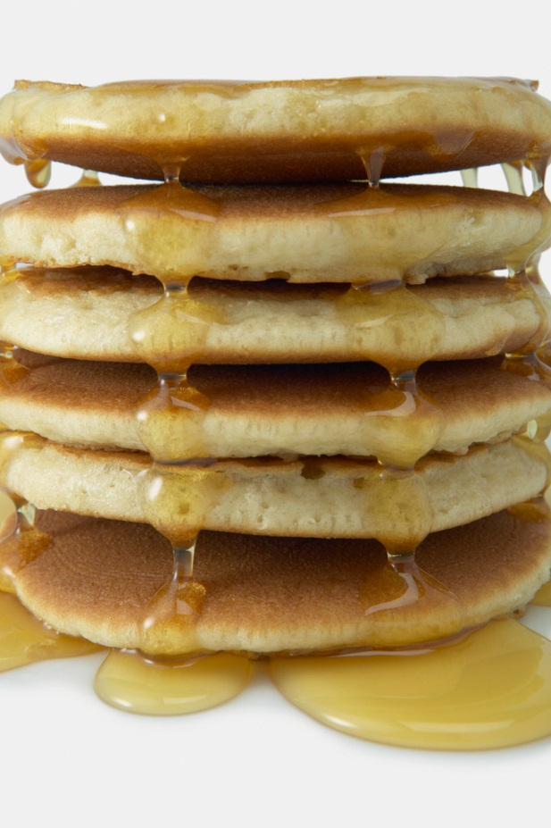
Stacks in Practice
Store pancakes on your plate (does it bother you that you eat them in the opposite order they were put down?)
Function call stack
Implementing/removing recursion
Balancing symbols (parentheses)
Evaluating Reverse Polish Notation
Depth first search

Slide 33
Example Stolen from Alan Hu ☺ “Call Stack” and Recursion
int fib(int n) {
if (n <= 2) return 1;
int a = fib(n-1);
int b = fib(n-2);
return a+b;
}
Suppose we call fib(4):
Line 1, n=4
This is our stack. It’s a stack of program points and variable values.
(location of fib(4) call goes here)

Slide 34
“Call Stack” and Recursion
int fib(int n) {
if (n <= 2) return 1;
int a = fib(n-1);
int b = fib(n-2);
return a+b;
}
Suppose we call fib(4):
Line 2, n=4, a = fib(3)
Making a function call pushes a new “frame” onto the stack.
(location of fib(4) call goes here)

Slide 35
“Call Stack” and Recursion
int fib(int n) {
if (n <= 2) return 1;
int a = fib(n-1);
int b = fib(n-2);
return a+b;
}
Suppose we call fib(4):
Line 1, n=3
Line 2, n=4, a = fib(3)
Making a function call pushes a new “frame” onto the stack.
(location of fib(4) call goes here)

Slide 36
“Call Stack” and Recursion
int fib(int n) {
if (n <= 2) return 1;
int a = fib(n-1);
int b = fib(n-2);
return a+b;
}
Suppose we call fib(4):
Line 2, n=3, a = fib(2)
Line 2, n=4, a = fib(3)
(location of fib(4) call goes here)

Slide 37
“Call Stack” and Recursion
int fib(int n) {
if (n <= 2) return 1;
int a = fib(n-1);
int b = fib(n-2);
return a+b;
}
Suppose we call fib(4):
Line 1, n=2
Line 2, n=3, a = fib(2)
Line 2, n=4, a = fib(3)
(location of fib(4) call goes here)

Slide 38
“Call Stack” and Recursion
int fib(int n) {
if (n <= 2) return 1;
int a = fib(n-1);
int b = fib(n-2);
return a+b;
}
Suppose we call fib(4):
Line 1, n=2, return 1
Line 2, n=3, a = fib(2)
Line 2, n=4, a = fib(3)
Returning from a call pops the old “frame” off the stack.
(location of fib(4) call goes here)

Slide 39
“Call Stack” and Recursion
int fib(int n) {
if (n <= 2) return 1;
int a = fib(n-1);
int b = fib(n-2);
return a+b;
}
Suppose we call fib(4):
Line 2, n=3, a = 1
Line 2, n=4, a = fib(3)
Returning from a call pops the old “frame” off the stack.
(location of fib(4) call goes here)

Slide 40
“Call Stack” and Recursion
int fib(int n) {
if (n <= 2) return 1;
int a = fib(n-1);
int b = fib(n-2);
return a+b;
}
Suppose we call fib(4):
Line 3, n=3, a = 1, b = fib(1)
Line 2, n=4, a = fib(3)
(location of fib(4) call goes here)

Slide 41
“Call Stack” and Recursion
int fib(int n) {
if (n <= 2) return 1;
int a = fib(n-1);
int b = fib(n-2);
return a+b;
}
Suppose we call fib(4):
Line 1, n=1
Line 3, n=3, a = 1, b = fib(1)
Line 2, n=4, a = fib(3)
(location of fib(4) call goes here)

Slide 42
“Call Stack” and Recursion
int fib(int n) {
if (n <= 2) return 1;
int a = fib(n-1);
int b = fib(n-2);
return a+b;
}
Suppose we call fib(4):
Line 1, n=1, return 1
Line 3, n=3, a = 1, b = fib(1)
Line 2, n=4, a = fib(3)
(location of fib(4) call goes here)

Slide 43
“Call Stack” and Recursion
int fib(int n) {
if (n <= 2) return 1;
int a = fib(n-1);
int b = fib(n-2);
return a+b;
}
Suppose we call fib(4):
Line 3, n=3, a = 1, b = 1
Line 2, n=4, a = fib(3)
(location of fib(4) call goes here)

Slide 44
“Call Stack” and Recursion
int fib(int n) {
if (n <= 2) return 1;
int a = fib(n-1);
int b = fib(n-2);
return a+b;
}
Suppose we call fib(4):
Line 4, n=3, a = 1, b = 1, return 2
Line 2, n=4, a = fib(3)
(location of fib(4) call goes here)

Slide 45
“Call Stack” and Recursion
int fib(int n) {
if (n <= 2) return 1;
int a = fib(n-1);
int b = fib(n-2);
return a+b;
}
Suppose we call fib(4):
Line 3, n=4, a = 2, b = fib(2)
(location of fib(4) call goes here)

Slide 46
“Call Stack” and Recursion
int fib(int n) {
if (n <= 2) return 1;
int a = fib(n-1);
int b = fib(n-2);
return a+b;
}
Suppose we call fib(4):
Line 1, n=2
Line 3, n=4, a = 2, b = fib(2)
(location of fib(4) call goes here)

Slide 47
“Call Stack” and Recursion
int fib(int n) {
if (n <= 2) return 1;
int a = fib(n-1);
int b = fib(n-2);
return a+b;
}
Suppose we call fib(4):
Line 1, n=2, return 1
Line 3, n=4, a = 2, b = fib(2)
(location of fib(4) call goes here)

Slide 48
“Call Stack” and Recursion
int fib(int n) {
if (n <= 2) return 1;
int a = fib(n-1);
int b = fib(n-2);
return a+b;
}
Suppose we call fib(4):
Line 3, n=4, a = 2, b = 1
(location of fib(4) call goes here)

Slide 49
“Call Stack” and Recursion
int fib(int n) {
if (n <= 2) return 1;
int a = fib(n-1);
int b = fib(n-2);
return a+b;
}
Suppose we call fib(4):
Line 3, n=4, a = 2, b = 1, return 3
(location of fib(4) call goes here)

Slide 50
“Call Stack” and Recursion
int fib(int n) {
if (n <= 2) return 1;
int a = fib(n-1);
int b = fib(n-2);
return a+b;
}
Suppose we call fib(4):
(code that called fib(4) resumes w/value 3)

Slide 51
Array Stack Data Structure
Q
0
1
2
…
7
…
size - 1
a
b
c
d
e
f
g
h
top
7
(int)
void push(char x) {
assert(!is_full())
S[top] = x
top++
}
char top() {
assert(!is_empty())
return S[top - 1]
}
char pop() {
assert(!is_empty())
top--
return S[top]
}
bool is_empty() {
return top == 0
}
bool is_full() {
return top == size
}

Slide 52
Let’s Trace How It Works
push B
pop
push K
push C
push A
pop
pop
pop

Slide 53
Linked List Stack Data Structure
top
data
next
data
next
data
next
'b'
'c'
'd'
(Node*)
(char)
(Node*)
(char)
(Node*)
(char)
(Node*)
void push(char x) {
temp = top;
top = new Node(x);
top->next = temp;
}
char top() {
assert(!is_empty())
return top->data;
}
char pop() {
assert(!is_empty())
char return_data = top->data;
temp = top;
top = top->next;
delete temp;
return return_data;
}
bool is_empty() {
return top == nullptr;
}

Slide 54
Let’s Trace How It Works
push B
pop
push K
push C
push A
pop
pop
pop

Slide 55
Data structures you should already know (a bit)
Arrays
Linked lists
Trees
Queues
Stacks

Slide 56
To Do
Check out the web page and Piazza
Download and read over Lab 1 materials
Begin working through Chapters P and 1 of Koffman and Wolfgang (C++ background)
Read 4.5-4.7, 5, and 6 (except 6.4) of Koffman and Wolfgang (linked lists, stacks, queues)
ALWAYS when reading the text:
DO the exercises!
ASK questions!
Notes:
TODO (future terms): doublecheck readings, update online resources

Slide 57
Coming Up
Asymptotic Analysis
Quiz/Written Assignment 1
Programming Project 1

